Slide 1

Accelerating Collaborations in Science
Paraskevi Massara, PhD candidate
Dep. Nutritional Sciences, Faculty of Medicine, University of Toronto
Div. Translational Medicine, The Hospital for Sick Children

Slide 2
Dr. Elena Comelli and Dr. Robert Bandsma
Mission-Vision
Go beyond traditional statistical methods and explore novel machine-learning approaches.
Improve the robustness of studies on growth and microbiome.
Systematize and automate methodologies and facilitate comparisons and reproducibility.
PhD thesis: Association between growth, diet and gut microbiome in peripubertal children from the Target Kids! cohort.
Resources and Tools
Centre For Computational Medicine High Performance Computing Facility (CCM HPF) - The Hospital for Sick Children
Compute Canada
R, Python, GitHub

Slide 3
Scientific collaborations over time
1955
1981
1999
2000
Team size increased by 99.4%
Team size increased by ~50%
2.4 million scientific articles produced by the top 110 US universities
5* increase in collaboration between US and foreign universities
Adams, JD, et al (2005), Research Policy, Wutchy, S, et al. (2007).Science

Slide 4
Why collaborations are important?
Great challenges of our time (public health, treatment of malnutrition, energy sustainability) are difficult to be treated by individuals alone
Build stronger and more equal scientific partnerships
Complicated scientific questions require diverse backgrounds, often across borders
FUTURE YOU, maybe the most important collaborator.

Slide 5




Who is a collaborator?
Sharing or openness does not directly lead to collaboration
A level of coordination is required in addition to sharing

Slide 6
Key elements of collaboration “Speaking the same language”
Decide on common tools, formats and programming languages early on the project.
Open source software might be helpful
Make your artifacts easy to understand for everyone in the team.
Settle on terminology early in the project. Create a project dictionary.

Slide 7
Key elements of collaboration “Sharing is caring”
Create formal channels to share data, code, information, knowledge.
Ensure that you share only what can be shared.
Practice secure sharing.
Define access rights and roles, use passwords, encryption.
Sharing through formal channels ensures traceability and protects ownership.

Slide 8
Key elements of collaboration “The three Cs of success”
Communicate
Talk often, share often, build a community.
Coordinate
Keep tasks and responsibilities in order.
Synchronize often.
Collaborate!
Solve problems together, make recommendations

Slide 9


GitHub and R
Share
Communicate
Coordinate
Collaborate

Slide 10
Agenda
History and value of collaboration
Software Engineering in Health and Society
Coding styles
Introduction to GitHub interface
Create a repository
GitHub Desktop App
Clone a repository
My first commit
Pushing to and Pulling from the Stream
My first issue
Making changes
My second commit!
Closing an issue
Pull requests
Merge and conflict resolution
Projects and Milestones
Insights (stats and visualizations)
Branches and Forks

Slide 11
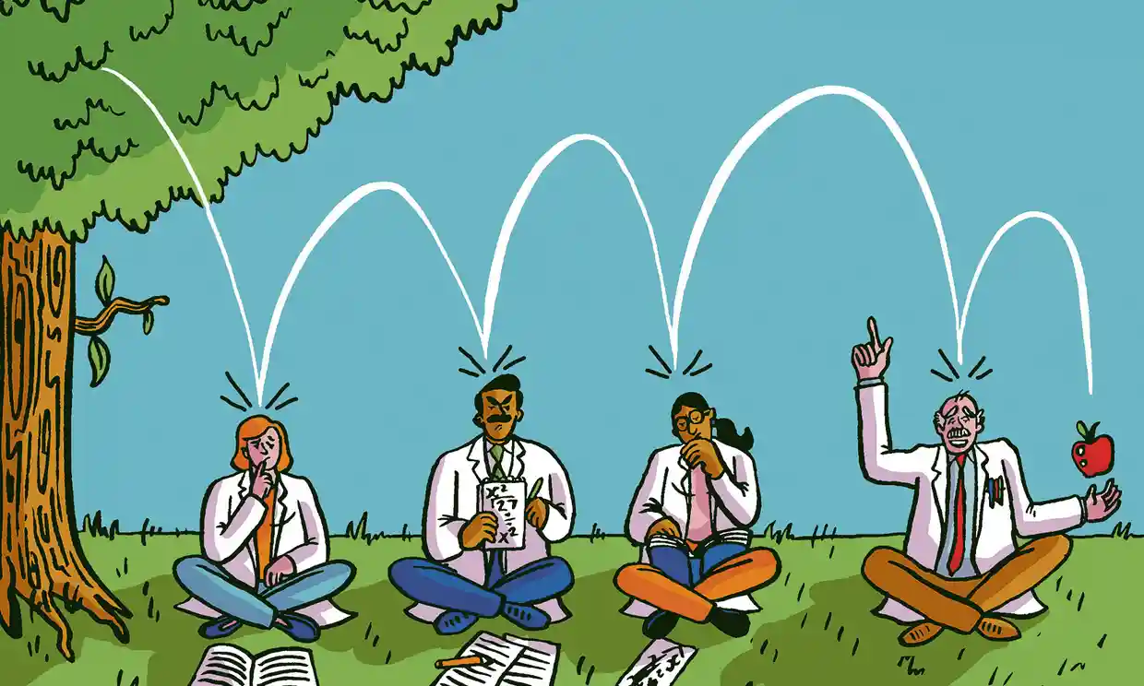

Thank you!
Whenever a communication medium lowers the costs of solving collective action dilemmas, it becomes possible for more people to pool resources. And “more people pooling resources in new ways” is the history of civilization in…seven words.
— Marc Smith, research sociologist at Microsoft
https://github.com/massaraevi/GitHub_workshop2020
http://individual.utoronto.ca/p_massara/
p.massara@mail.utoronto.ca
Illustration: Dominic McKenzie, “The Guardian”, 2017

